Slide 1
LINKEDIN
& NETWORKING
Nicole Palidwor | Denver Outcomes | 2018
Notes:
Make sure markers and name plaques are on desks!

Slide 2

BECOMING A JOB SEEKER
In order to qualify for Outcomes support, you’ll need to complete the following within two weeks of graduation. IDEALLY, by end of the course!
Participation in All Outcomes Programming& Surveys
Digital Presence (LinkedIn + GA Profile)
Job Search Tracker Participation
Networking (2 through the course)
Online
Portfolio
Resume
Notes:
Quality check, best foot forward - I will review your resume, LinkedIn, GA Profile, portfolio, and job tracker.
This will qualify you as a job seeker and kick off your job search.
You must be qualified within 4 weeks of completion of the program (pending specific circumstances) to receive my full support.

Slide 3
OUTCOMES EXPECTATIONS - Due April 4th
Week Two:
What’s my brand worksheet
o https://goo.gl/forms/s7qDGunivtjm2cub2
Work on LinkedIn using LinkedIn check sheet
o https://docs.google.com/document/d/1_hUYTTiR-r7IZW6176g7xBtE4EHXDTVPt45qhc1VX8s/edit
Identify one meet up to attend while in class
Reach out to one of the alumni you met last week with a personalized greeting and ask to meet or have a one-on-one chat about their experience and ask for any advice they may have (either the panel or post-class group)

Slide 4
DEVELOPING YOUR NETWORK
Notes:
Goal: Of course, driving towards job ready by day 1 of post-course.

Slide 5
AGENDA
Networking
Purpose
Tools
LinkedIn Profiles

Slide 6
OBJECTIVES
The purpose of networking
How to network effectively
What tools to use to effectively network
Understand the importance of LinkedIn
How to set-up a superstar LinkedIn
How to use LinkedIn as a networking tool & community contributor

Slide 7
DEVELOPING YOUR NETWORK
WHY BUILD A NETWORK?
Notes:
What is it and why is this important?
Learning to SELL YOURSELF.

Slide 8

WHY BUILD A NETWORK?
Notes:
What is the Hidden Job Market?
what job board can I go to to find the hidden jobs?

Slide 9
NETWORKING ADVANTAGES
WHY BUILD A NETWORK?
Best way to find a job with people you really like
Posted jobs draw too many applicants (250 apps average)
Many jobs are filled before they're posted (up to 80% never posted)
Notes:
Tell story of hiring Heather

Slide 10
NETWORKING CHALLENGES
WHY BUILD A NETWORK?
Having to talk to strangers
Having to brag about yourself to strangers
May be turned down after bragging about yourself to a stranger
Might knock things off of a display table while being turned down after bragging about yourself to a stranger
Notes:
Networking may seem intimidating for a lot of us: self serving, pushy, fear of rejection

Slide 11
DEVELOPING YOUR NETWORK
JUST LIKE DESIGNING AND DEVELOPING, YOU WILL GET BETTER THE MORE YOU FAIL

Slide 12
HOW TO GET STARTED FAILING
WHY BUILD A NETWORK?
‹#›￼
The sooner you start meeting people + becoming a familiar face, the better.
Built In Colorado - (listing of tech companies started in Colorado
Startup Denver - (multiple relevant links)
Newtech Colorado - (job board and community building)
Data Science Weekly - (meetups & resources)
Meetup.com - (keyword search for relevant happenings)
Notes:
Hint hint - if you go to Denver Script, you already have a familiar face there - Matt Webb

Slide 13

REALITY:
YOU ARE ALWAYS NETWORKING
Notes:
You have now learnt enough of your skill set to speak to what you’re learning and how it is of benefit to organizations and the industry as a whole. People will be in awe of your awesome scienceness so it’s actually a great topic of conversation for networking
you are now promoting you brand constantly. Its just a matter of where you choose to be - in some spaces your skills will be usesless, in others they will be pivotal.
If not outright networking events, try spending your time socializing in groups that might need your skills. For instance, I run a writing group, and when people hear that I make websites, they always want advice on how to make an author page or how to digitize their manuscripts.

Slide 14
BUILDING YOUR NETWORK
HOW DO YOU TALK TO STRANGERS?

Slide 15
TALKING TO STRANGERS
Fact: People love to talk about themselves and what they're passionate about. Frame your questions around a general interest in them.
What do you do?
How did you get started doing that?
What kinds of languages/environments do you work with?
Do you like it?
What do you WANT to be doing?
Learn anything cool recently?
Deal with anything lately you think is a waste of time?
Got any advice for someone new to _________ ?
(could be the industry, a language, a program, etc.)
Notes:
Avoid asking questions that are overtly job-seeking - i.e., don't start with "Hi I'm Nick, is your company hiring?" When you ask me that, my answer varies depending on who you are (and who I think you are).
Give someone the chance to get a read on you before you hit them up for anything that might feel like work or a favor. More than anything, ask questions that put your interest in and passion for development first.

Slide 16
WHAT TO HIGHLIGHT
Your work ethic
Agility: You work on projects in 1 week sprints
You are a quick learner and are extremely teachable
You have worked on X Projects and know X skills….

Slide 17
TALKING TO STRANGERS
More subtle ways to network:
“I cannot stop eating these cookies - have you tried them?!”
“OMG. I can’t believe how underdressed I am for this.”
“So, on a scale of 1 to undrinkable, how terrible is the Chardonnay?”
“I’ll be honest, the only person I know here is the bartender, and I just met him two minutes ago . . . Do you mind if I introduce myself?”

Slide 18
TIPS
Be yourself and have fun
Bring a friend/ colleague
Make it a game
End the conversation pleasantly

Slide 19
MAINTAINING THE NETWORK
WHAT QUESTIONS CAN YOU ASK?
Don’t wait until you need something!
Email, call, get coffee/ lunch/ rock climbing (or any other common interest!)
Remember birthdays, favorite sports teams, important personal info
Ask for updates – promotions, new jobs, blogs, etc
Congratulate them on significant events
^^^ Within reason. Don't be a stalker.
Notes:
Stay in touch
Use every free moment to connect / re-connect with someone
Congratulate them on significant events
Don't be weird

Slide 20
WHAT QUESTIONS CAN YOU ASK?
LET'S PRACTICE!
PRETEND I AM SOMEONE YOU WANT TO CONNECT WITH
Strike up a conversation with me, then close by getting my contact info
Notes:
hopefully not too hard :P

Slide 21
BUILDING YOUR NETWORK
BUILDING YOUR DIGITAL NETWORK
I.E. Talking to strangers on the internet
Notes:
A huge amount of your networking will be online. There's 2 basic steps:
Building your digital network
Reaching out to your digital network
These are two very different things - getting people to follow you is easy, reaching out to them IRL is not.

Slide 22
TALKING TO STRANGERS ON THE INTERNET
Same rules as before - people love to talk about themselves, and what they're passionate about. IRL interaction techniques generally work just as well online.
Be brief - don't write a stranger a long, serial-killer email
Be nice/complimentary
Trail with a question - this implies that you desire a response
Try to tailor your message to a recent tweet/article/event to ground it
Don't ask for anything besides information or an introduction.
Asking for a job or something that requires significant work on their end will come several messages down the line.
Thank them for their time
Notes:
Avoid asking questions that are overtly job-seeking - i.e., don't start with "Hi I'm Nick, is your company hiring?" When you ask me that, my answer varies depending on who you are (and who I think you are).
Give someone the chance to get a read on you before you hit them up for anything that might feel like work or a favor. More than anything, ask questions that put your interesting and passion for development first.

Slide 23
BUILDING YOUR DIGITAL NETWORK
Introduction
My name is ____ and I’m studying _________ at General Assembly in Denver.
Connection
I'm getting up to speed with the design/development scene in Denver, and I saw that you work at __________.
I'd love to learn more about your role, and what it's like to be a ________ at _______.
Specific Interest
Do you have 15 minutes next week to grab coffee and chat?
Call To Action
Notes:
100 words or less

Slide 24
WHAT QUESTIONS CAN YOU ASK?
WHO ELSE DO YOU KNOW?
Thanks so much for taking the time to tell me more about your role/the company. I’d like to keep learning more about development at companies like yours/with products like yours/people who have similar responsibilities etc. is there anyone that you could recommend me to and/or any companies that you suggest I try to reach out to?
Notes:
Bonus points

Slide 25
NETWORKING
BUILDING RELATIONSHIPS

Slide 26
WE LOVE DATA
A whopping 80% of jobs are found through networking.
Ask your peers at parties and reunions where they
found their jobs as tech workers, and I’m sure you will start hearing:
“Girlfriend’s brother recommended me” or “my friend works on the sales team.”
Most companies even offer a bonus of anywhere between $500-$10,000 to employees that refer a new hire to the team.

Slide 27

stock photo showing an unusual connection
NETWORKING

Slide 28
NETWORK AT GA
Start with DSI, UXDI and other WDI students
After you graduate, work on projects together. Get experience working with product managers and web developers. If you include 2-3 of your classmates you’ve essentially created a team.
Benefits:
An additional portfolio piece
Experience working in an agile environment that you can speak to in interviews
Networking
Community building

Slide 29
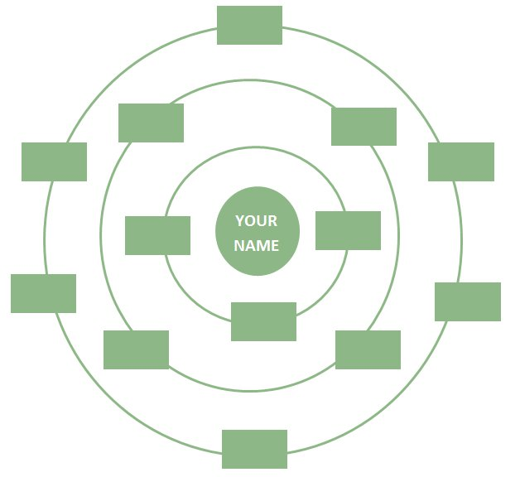
Circle of Influence Activity
Influential
Contacts
Strategic
Relationships
Everyday
Interactions
PRESENTATION TITLE

Slide 30
INFORMATIONAL INTERVIEW
Start Networking. Find people who have what you want and start learning how you can get to where they are. How? Reach out to them on LinkedIn!
Target those with similar backgrounds as you.
Ask if they would be willing to talk to you for 30 minutes.
Share that you’re just starting in this field and could use advice.
Ask if they can connect you to other people who can help.
Be relatable and authentic! Be YOURSELF! Connect with the person.
Remember: people like talking about their experience!

Slide 31
EMAIL EXAMPLES
I have been looking at your portfolio. You’ve done some pretty cool stuff! I found your X to be quite fascinating. It’s an interesting way designing X as it is both interesting and approachable. Brilliant. I would like to meet you and discuss how you come up with your ideas.
I am a web development student at General Assembly and I’m excited to expand my developer network. It was great to see you also have a background in X. I would love to buy you a cup of coffee and discuss how you made the transition so successfully.
I would like to buy you a coffee and ask you some advice on your career and how you got started as your work in X is exactly why I am studying web development at General Assembly. Let me know when you are available for 30 minutes to discuss your thoughts on Web Development and your process and I’ll coordinate my schedule to reflect your availability.

Slide 32
NETWORKING
BECOME A THOUGHT
LEADER
YOU MUST HAVE SOMETHING TO OFFER IN ORDER TO NETWORK EFFECTIVELY

Slide 33
INDUSTRY RESEARCH
Know what’s happening in the news. New tech releases, new products, companies, trends and innovations in WD.
Sign up for newsletters from the following:
TechCrunch - News in tech
Crunchbase - Company research; recent rounds of funding
VentureBeat - News in tech
Startup digest
Data School - Blogs, articles, and more

Slide 34
Contribute!
Twitter - Share solutions, news, thoughts on new
technologies, tweet at companies/industry leaders, etc.
Quora - Ask questions and answer questions
Medium - Start blogging, share your thoughts, build community!
LinkedIn - Share posts, contribute to groups, post content
PRESENTATION TITLE

Slide 35
GOAL SETTING
Set a goal and be specific
When you go to an event, ask yourself what the benefit of going would be.
Then set 2-3 objectives for attending.
I’m going to go to a web development meetup. Not a strong goal.
I’m going to go to a web development meetup.
I want to connect with at least 3 people there. Better goal.
I’m going to go to a web development meetup. I want
to connect with at least 6 people there. At least 2-3 of
those are going to turn into connections I will follow up with. GREAT GOAL!

Slide 36
DO’S
-Walk up to people and talk to them
-Don’t be afraid to get personal
-Tell stories and be yourself
-Add value before asking for something
-Ask open ended question
-Find common interests (projects, activities outside work, hobbies/places to check out)
-Ask for career advice
-Show flexibility in the conversation (react to your partner)
-Gather info on the industry they are in
-If you get stuck, share your reasoning for why you asked a question
-If the person seems like they’re losing interest, turn the convo to them and ask a question or their opinion
-Ask for advice on something that person has expertise in (great for creating a follow up!)
-Show passion in what you share
-Get business cards (jot down notes on the card right after talking to someone)
-Stay in touch (add them on twitter, LINKEDIN). Share interesting articles re: topics they expressed interest in)

Slide 37
DONT’S
-Waste time on a conversation that neither of you are invested in
-Talk about yourself the whole time
-Not say thanks if the person helps you
-Talk in circles
-Forget to follow up (48 hours max)
-Don’t be unaccountable if you promised something
-Ask yes/no questions

Slide 38
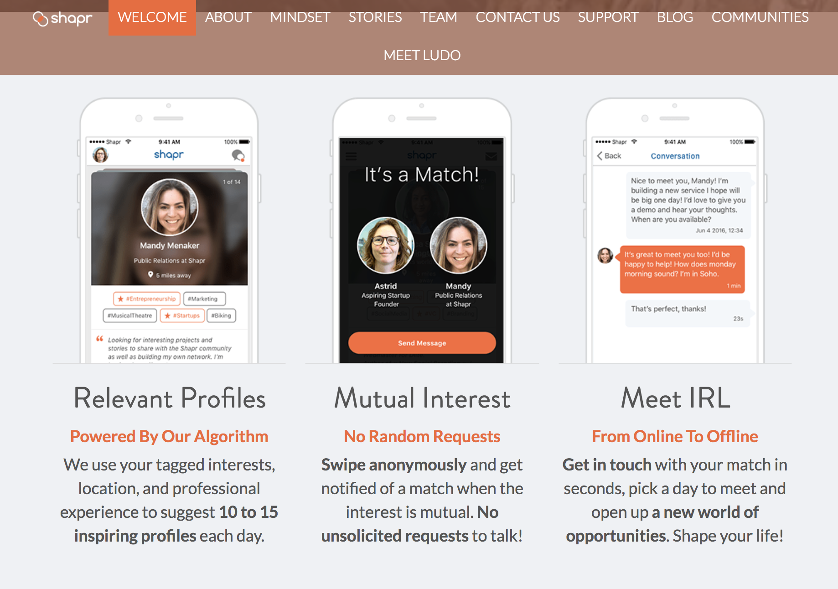
SHAPR.CO - The Tinder of the tech world that doesn’t suck
‹#›￼

Slide 39
Why is networking important?
Write 3 ways you can effectively network
STOP & JOT

Slide 40
LINKEDIN
OVERVIEW OF
LINKEDIN

Slide 41
DIGITAL PRESENCE AND LINKEDIN
Notes:
Hello
Welcome to LinkedIn Workshop
Purpose: Not just to create a LinkedIn but introduce the things that I and other recruiters would be looking for from your LinkedIn profile.
Disclaimer/Heads up - Working session - Give you time today to work on these items. This is the only time that we are going to work on your summary. So please use today’s time efficiently and productively to get this done and off your plate.
You will need your SUMMARY that we worked on together and then you will need the worksheet from workshop 1. With your skills, that you used to build your summary paragraphs.
Goal: Of course, driving towards job ready by day 1.

Slide 42
OBJECTIVES
Discuss why social media - specifically LinkedIn - is important for the job search and career changers.
Develop a professional LinkedIn page that reflects your newly acquired skills, professional goals and aligns with your personal brand.
Explain the importance of blogging to grow your network and stay on top of current industry trends/topics.
Notes:
“I don’t need a LinkedIn”
“I have never needed one”
Necessary Evil
We don't live in a world anywhere where you CANT have LinkedIn and be a job seeker. Especially a career changing job seeker. More than just finding your “digital presence,” You have to give employers a way to think about you. You have to tell them how to think about you.
But you don't have to have every section of LinkedIn filled out. There are only 6 places that really matter. But before that, we need to make some changes.

Slide 43
DIGITAL PRESENCE AND TOOLS
WHY IS A “PRESENCE” IMPORTANT?

Slide 44
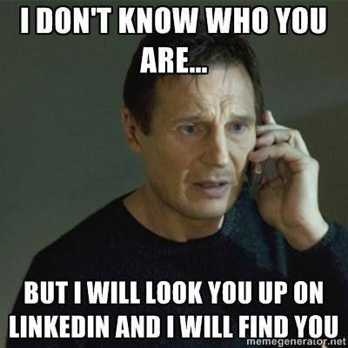
DIGITAL PRESENCE AND TOOLS

Slide 45
DIGITAL PRESENCE AND TOOLS
DIRECTIONS
Count off 1-12 and pair up with your number
Spend 2-3 minutes googling each other.
DELIVERABLE
What did you come up with? What impression do you get?
Notes:
Remember, they shouldn’t know what they’re going to design yet, since you can’t know what the solution is before you know the problem.
Share out (15m)
ASK: What are some topics people are interested in?
Instructor will facilitate a discussion around topics, may want to write them on the whiteboard.
Note: This is a great opportunity to nudge students away from some topics that may be too broad in scope, or too unsubstantial a topic.

Slide 46
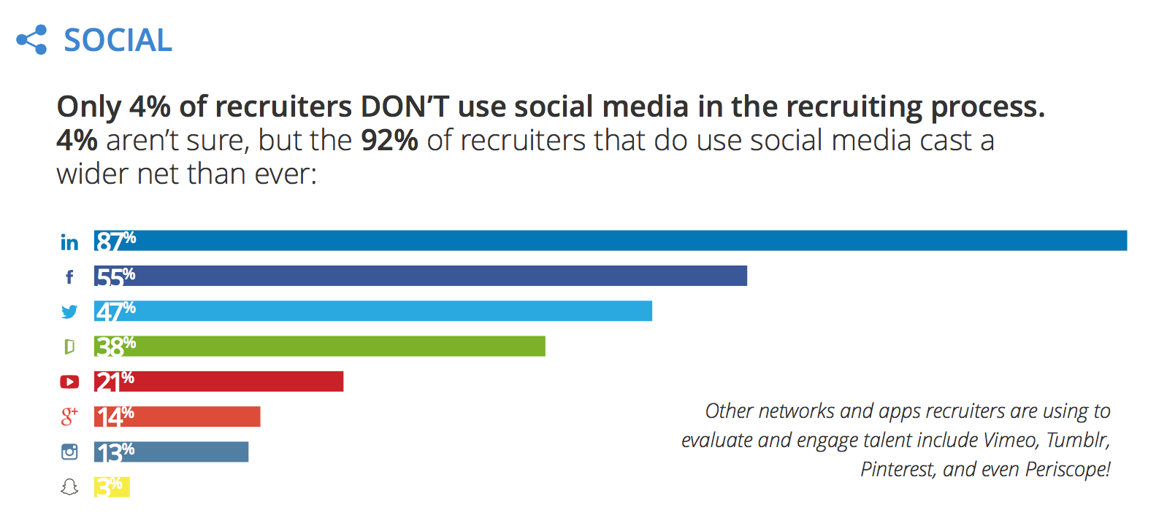
DIGITAL PRESENCE AND TOOLS
Notes:
“I don’t need a LinkedIn”
“I have never needed one”
Necessary Evil
We don't live in a world anywhere where you CANT have LinkedIn and be a job seeker. Especially a career changing job seeker. More than just finding your “digital presence,” You have to give employers a way to think about you. You have to tell them how to think about you.
But you don't have to have every section of LinkedIn filled out. There are only 6 places that really matter. But before that, we need to make some changes.

Slide 47
LINKEDIN FOR CAREER CHANGERS
LINKEDIN
WORK SESSION

Slide 48

LINKEDIN FOR CAREER CHANGERS
SETTINGS

Slide 49
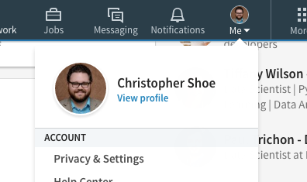
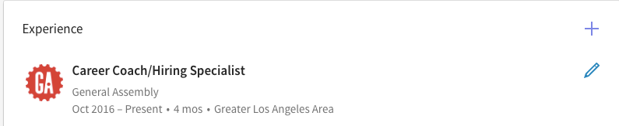
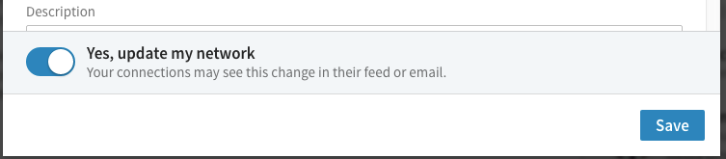
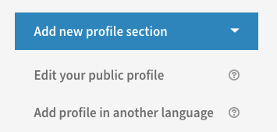
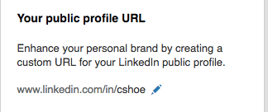
THE BASICS & WHAT’S IMPORTANT
Notes:
Turn off Notifications - Turn back on and make small change - when ready to job search.
Custom Link
Move sections around

Slide 50
LINKEDIN FOR CAREER CHANGERS
THE BASICS & WHAT’S IMPORTANT?
Notes:
But you don't have to have every section of LinkedIn filled out. There are only 6 places that really matter. But before that, we need to make some changes.

Slide 51

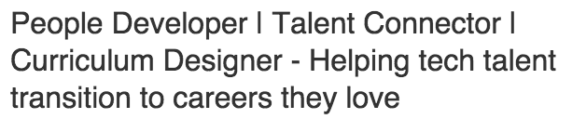




THE BASICS & WHAT’S IMPORTANT
Notes:
Completed LinkedIn training for all ~13 sections of LinkedIn. Not necessary. New Linkedin does not let you reorder - but the sections we focus on are still ordered according to our priority level.
There are really only 6 places that matter on LinkedIn.
Name - Headline - Summary - Experience - Projects - Education

Slide 52
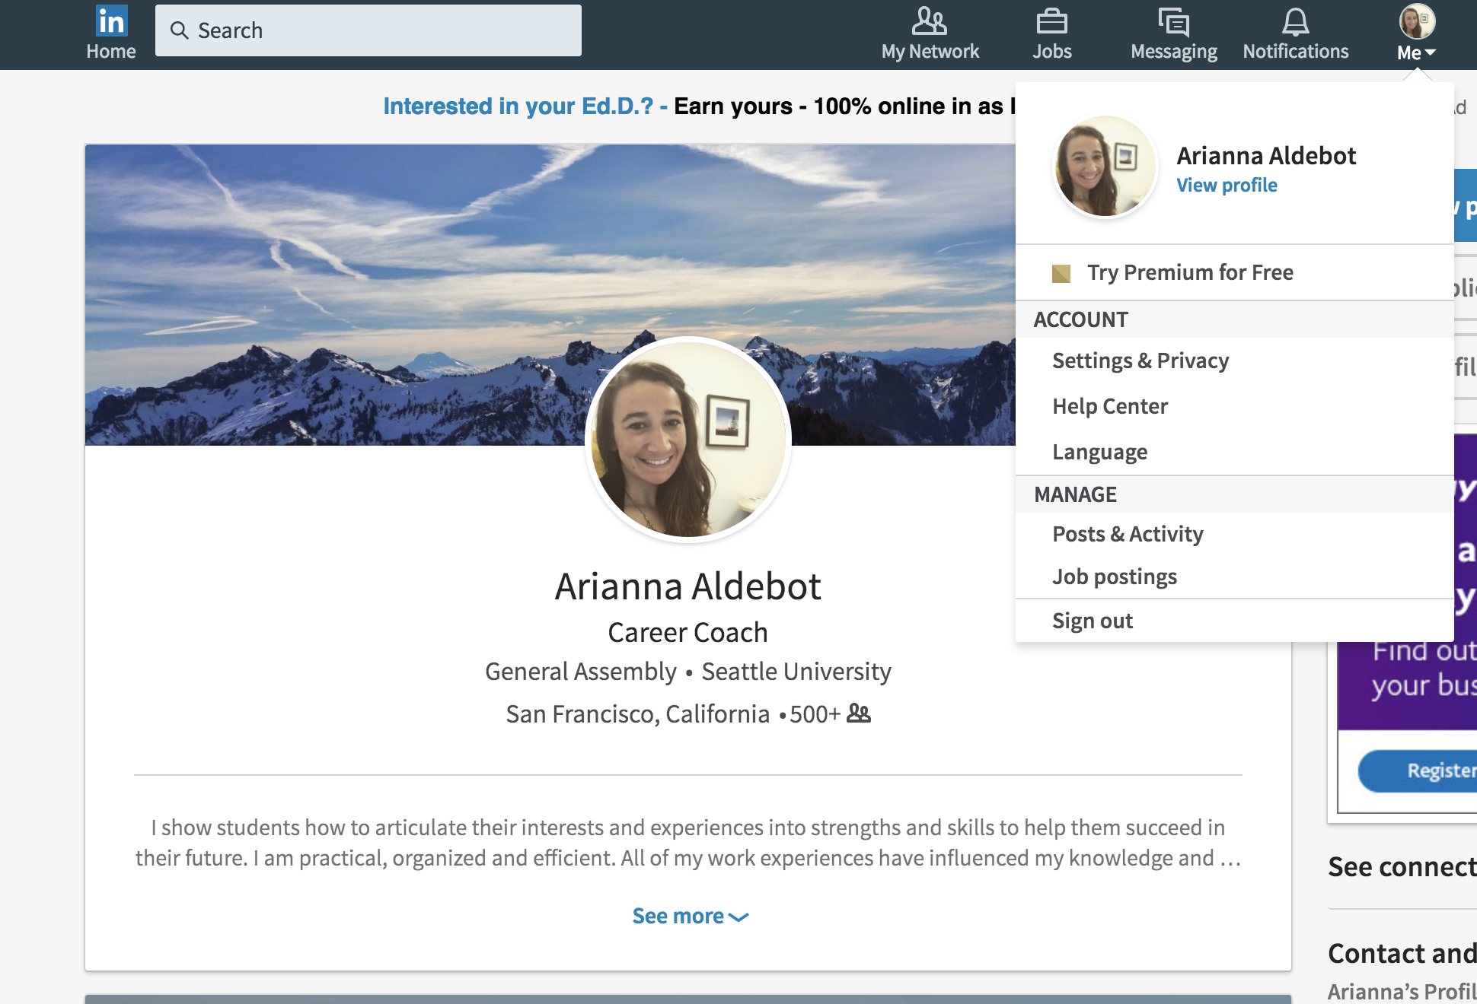
DISABLE UPDATES–SETTINGS/PRIVACY/SHARING PROFILE EDITS

Slide 53
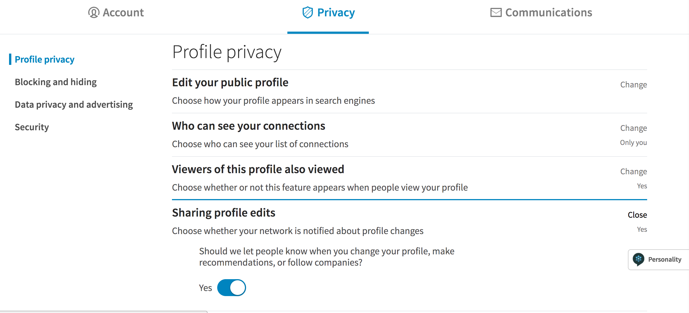
DISABLE UPDATES

Slide 54
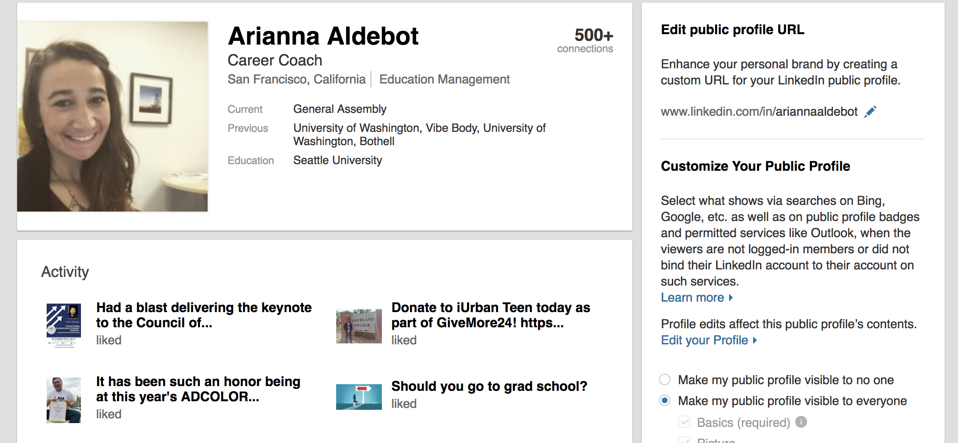
CUSTOM URL–SETTINGS/PRIVACY/EDIT PUBLIC PROFILE

Slide 55
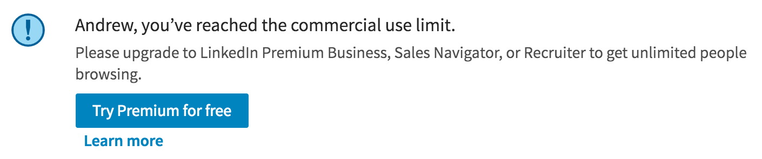
SEARCH LIMIT
Outsmart the system by going to this link:
http://recruitmentgeek.com/tools/linkedin/

Slide 56
HEADLINE AND PHOTO
Recruiters scan through hundreds of LinkedIn profiles daily. Here's the inside scoop:
The top two most important elements of your LinkedIn profile are your picture and headline. This is because these two sections are the first things recruiters see when you show up in a search.
Translation: your picture should be professional, and your tagline compelling.

Slide 57
LINKEDIN FOR CAREER CHANGERS
NAME & HEADLINE
Notes:
Draw [NAME] and [HEADLINE]

Slide 58
KEYWORD SEARCH
Pay Attention to Your Professional Headline.
The most prominent branding message on your LinkedIn Profile is also the most critical when it comes to SEO. Next to your Name, your Professional Headline, the phrase that appears below your name, is the most highly rated field in the index.
Keywords listed in the Headline field will have a greater impact, increasing your ranking among other users for the same terms.

Slide 59
KEYWORD SEARCH
Three or four keywords that represent what you do.
Three or four keywords others use when needing your services.
How are you different from others with the same job title?
Identify what decision-makers care about when they hire someone like you.
Be specific.
Use a human voice.

Slide 60
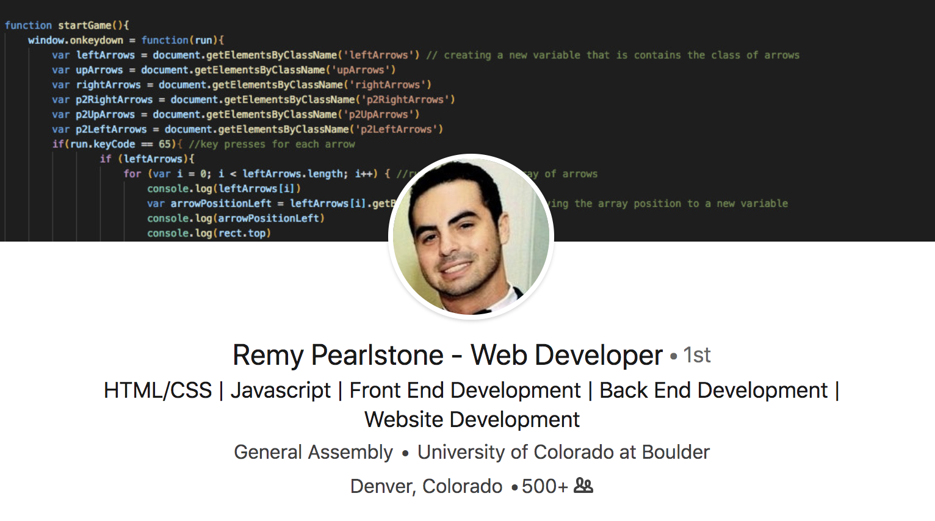
HEADLINE AND PHOTO

Slide 61
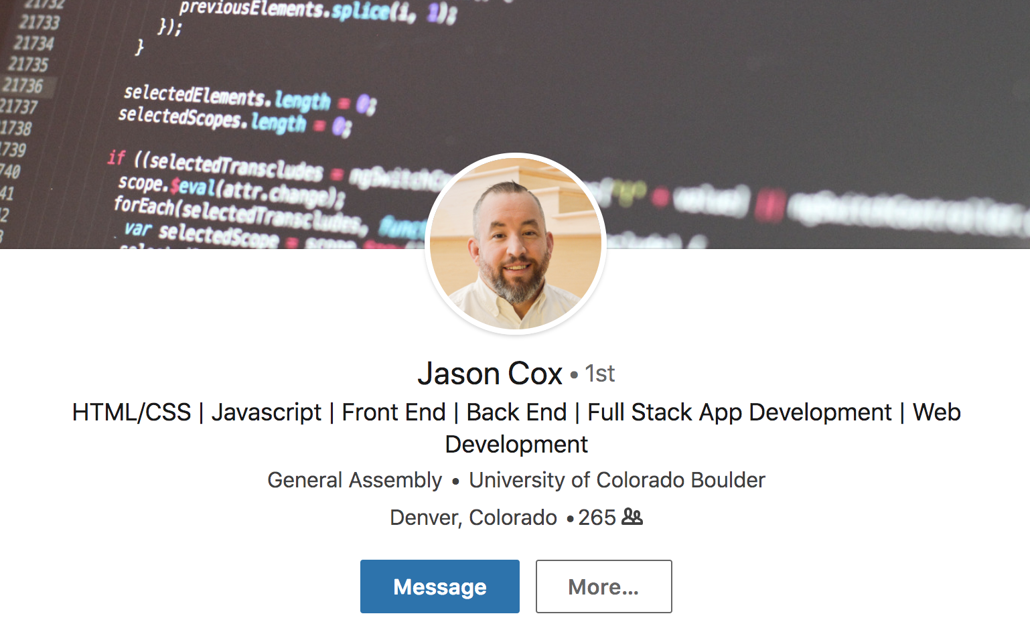
HEADLINE AND PHOTO

Slide 62
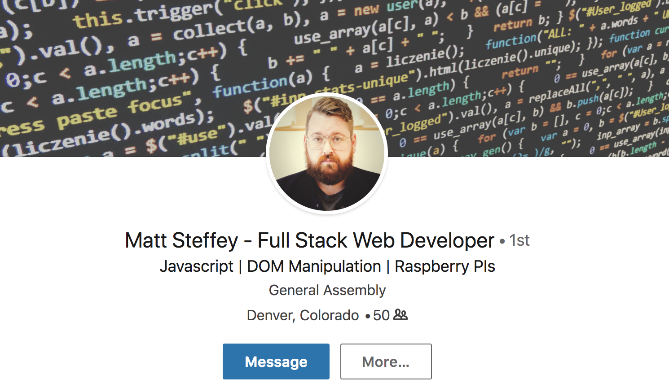
HEADLINE AND PHOTO

Slide 63
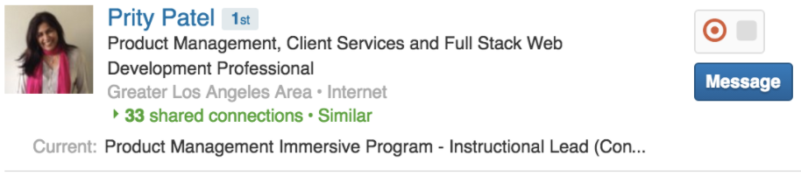
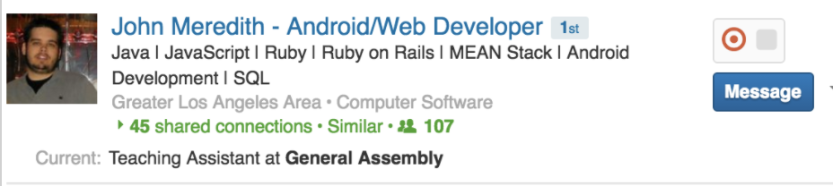
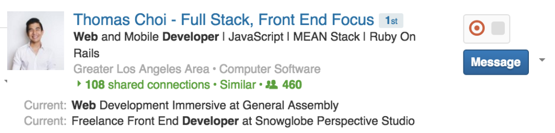
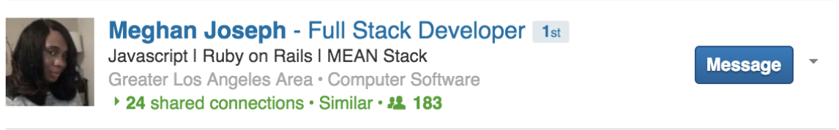
NAME & HEADLINE

Slide 64
LINKEDIN
KEYWORD SEARCH

Slide 65
KEYWORD SEARCH
LinkedIn is a very large database of profiles that uses key fields to order (or "index") the entire collection of data.
Since most of LinkedIn's revenue is generated by recruiters using LinkedIn to find candidates, LinkedIn knows the best keywords for personal SEO (search engine optimization).

Slide 66
KEYWORD SEARCH
Front End Developer & Designer Web Developer | JS | Node Backend Developer | Database Architect | IPA Enthusiast Developer with a background in Medical Technology Designer & Artist turned Developer
UX Developer | Sketch | Photoshop | HTML | CSS | JS Frontend Engineer | HTML | CSS | Heavy JS Backend Developer | Heavy JS | PHP | Ruby Web Developer | Full Stack Technical Lead | HTML | CSS | JS | Architecture | Management Creative Technologist | Unicorn | Design | Front End | Back End

Slide 67
KEYWORD SEARCH
Change Web Developer
to
Full Stack Developer with a passion for Agile and Project Planning
or
Frontend Developer | HTML | CSS | JS

Slide 68
LINKEDIN FOR CAREER CHANGERS
SUMMARY
Notes:
Draw [SUMMARY]
Again go back to a recruiters experience…
Now, I have gone through all of pages of candidates and clicked on your profile. Now what do I want to see?
In the world of 6 second recruiting, I want to see everything that I need to know right at the top. Especially important for a career changer because otherwise, in a 6 second scan,I would scroll down to your experience and education and not see any depth of experience.
You have your summaries already. Go ahead and paste it into your LinkedIn. This is normally what would take most grads the greatest amount of time in this workshop. But you all have the benefit of having it nearly completed.
But, it is still missing something…

Slide 69
SUMMARY
The summary briefly describes what kind of work you do, but more importantly: why people should hire you.
This is also where you should list your specific skills. If your headline is “web developer”, fill in the skills and applications you’re proficient with.

Slide 70
SUMMARY
Use Your Summary for Additional Keyword Content.
Your Summary should contain compelling text, along with a high percentage of keywords relevant to your goal.
Summary language employs more robust keyword content than a resume summary - so don’t just duplicate your resume on your LinkedIn summary.

Slide 71
SUMMARY
My name is _____ and I’m a _____
+
Present (What Do You Do?) (3 Skills)
+
Past (What Did You Do Before GA?) (3 Skills/Examples)
+
Future (What Do You Want To Do Next?)
Notes:
The skills that you incorporated in your summary, those are the skills that you have to replicate in your experience section.
Refer back to drawing. Connect {arrows} summary to experience with skills
Employers want to know your skills up front (summary) and then want to see those skills reinforced down in the experience

Slide 72
SUMMARY
Be brief (though there is a certain amount of creative freedom)
Engaging first sentence
Avoid I, I, I, I, I

Slide 73
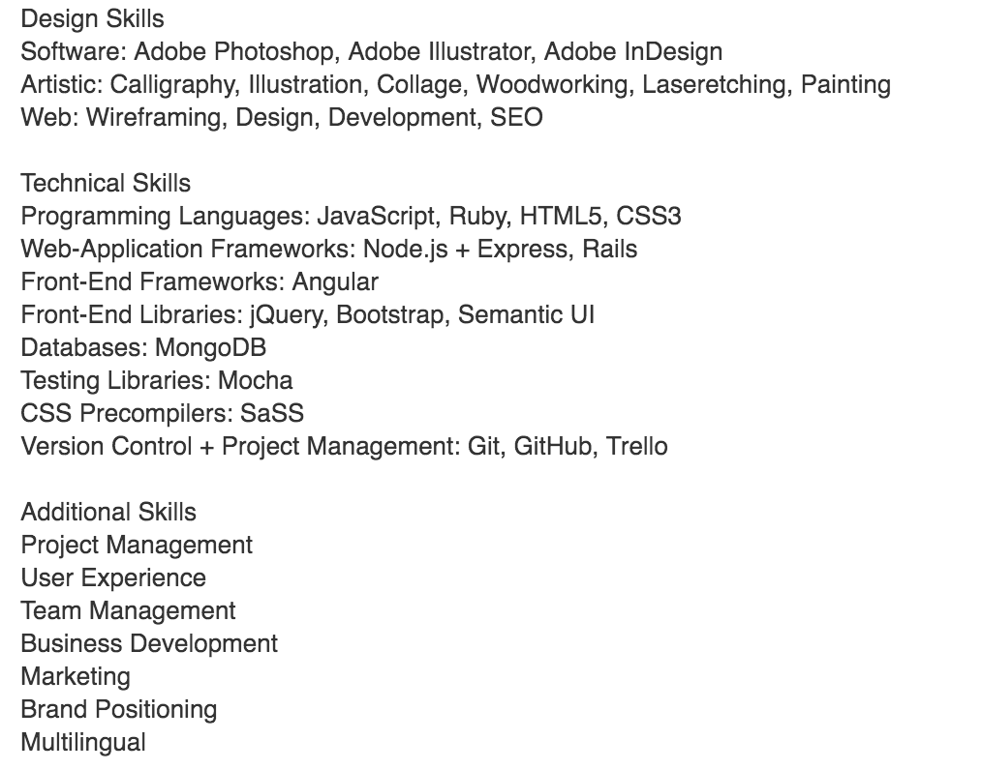
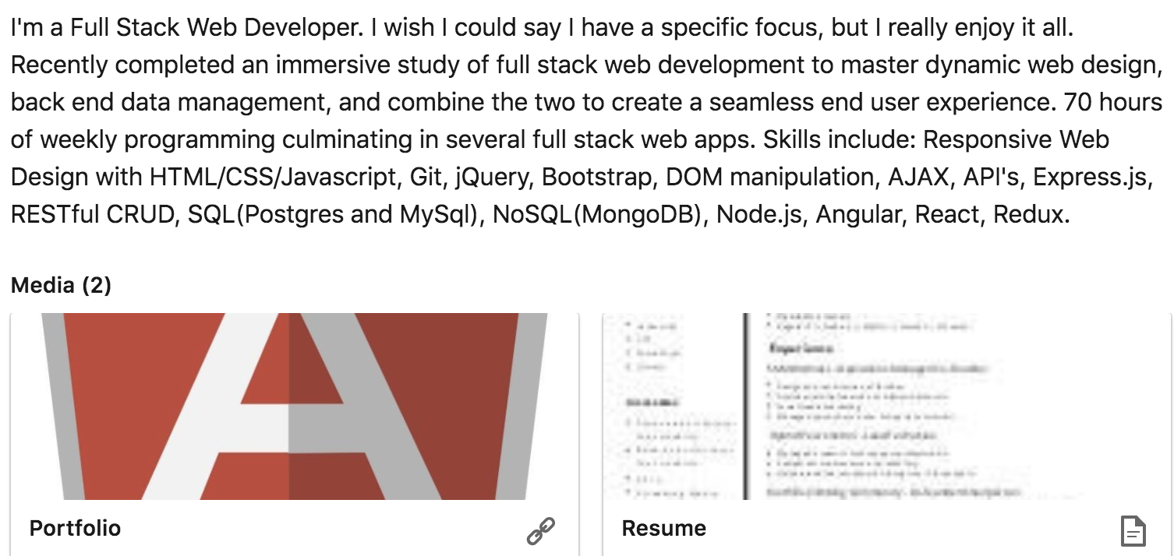

SUMMARY - Examples
Notes:
Skills - You need your bucket of skills right after your summary.

Slide 74
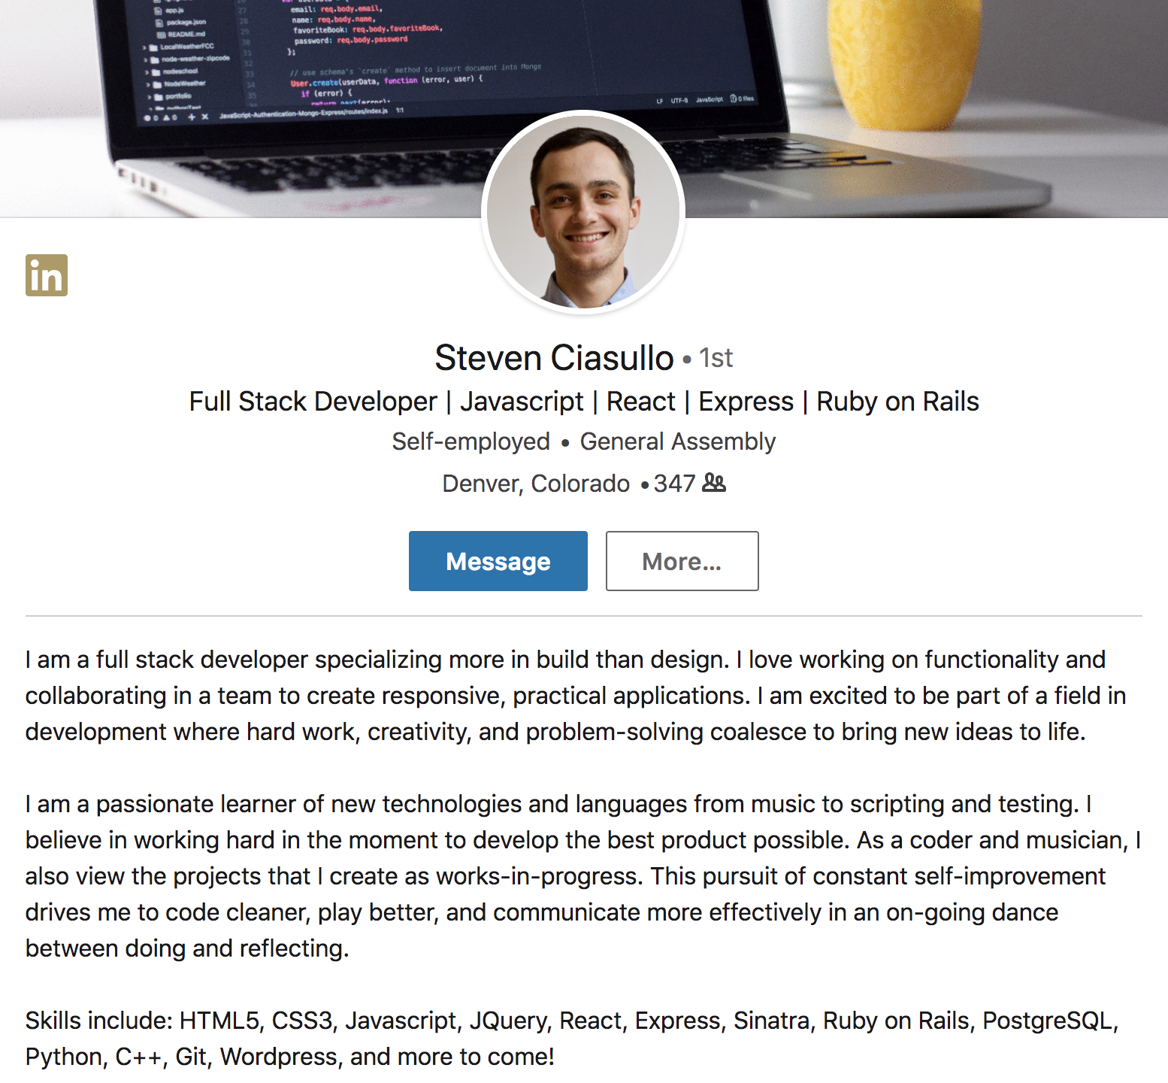
SUMMARY - Examples
Notes:
Skills - You need your bucket of skills right after your summary.

Slide 75
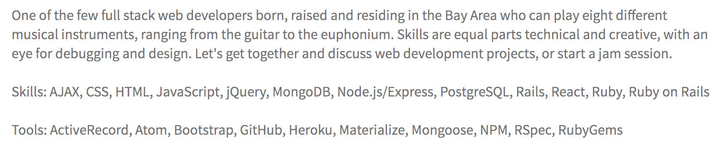
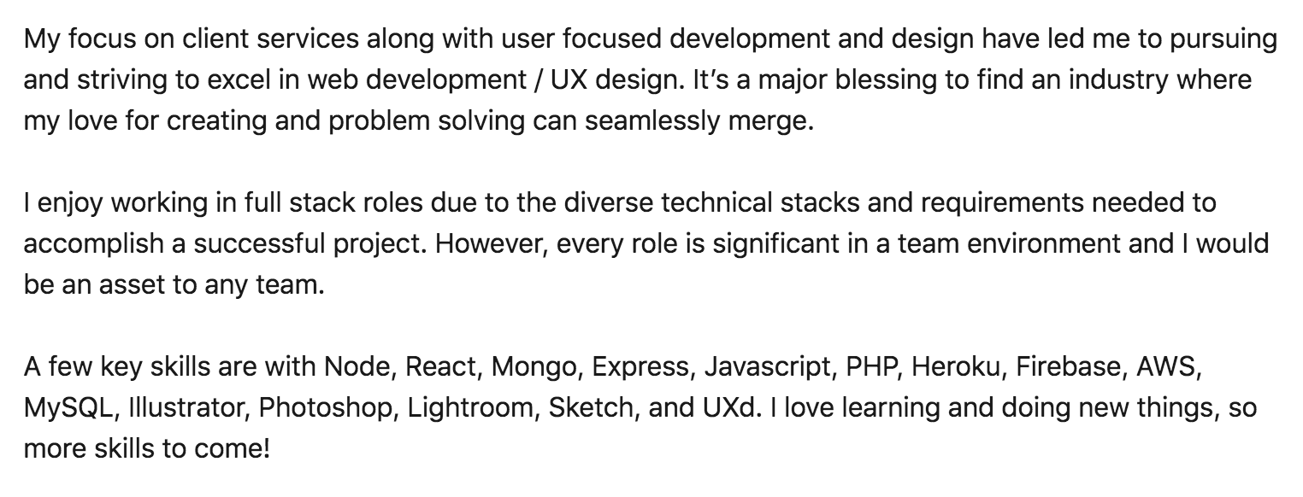
SUMMARY - Examples

Slide 76
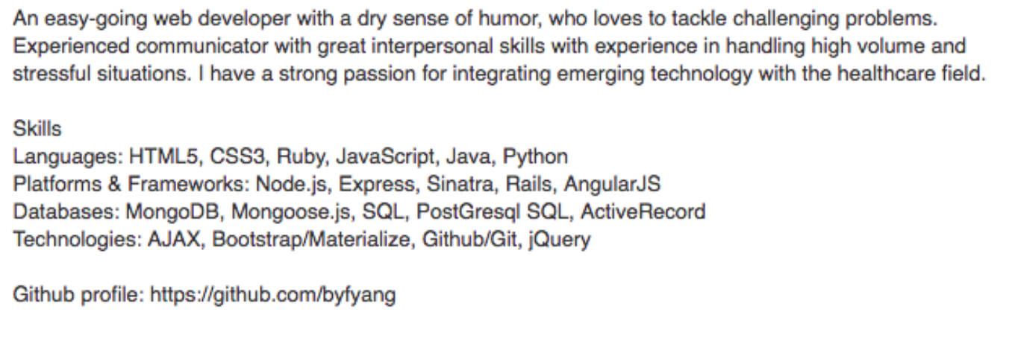
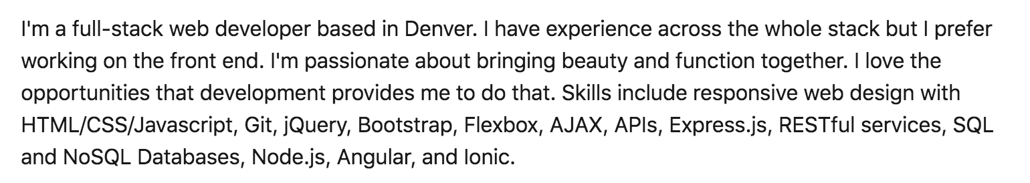
SUMMARY - Examples

Slide 77

DRAFT
In pairs, constrain yourself to 2-3 sentences and write a
summary for yourselves.
Groups of 2 - 3
‣3 mins
‣Group share + Provide Feedback
What can be improved? Did you find the summary
compelling?
PRESENTATION TITLE

Slide 78
LINKEDIN FOR CAREER CHANGERS
EXPERIENCE
Notes:
Draw [EXPERIENCE]
The truth is… there are a lot of ways to do experience but there is one minimum thing you have to do…
From having something super built out with lots of bullets to having nothing at all.

Slide 79
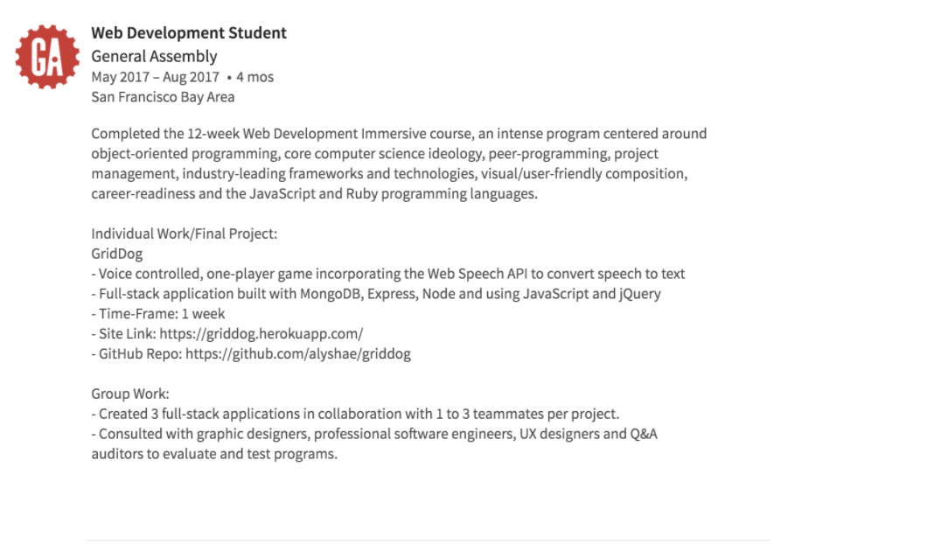
EXPERIENCE
GA listed in experience:
Brief blurb about the program
List projects
Responsibilities
Process
Deliverables

Slide 80
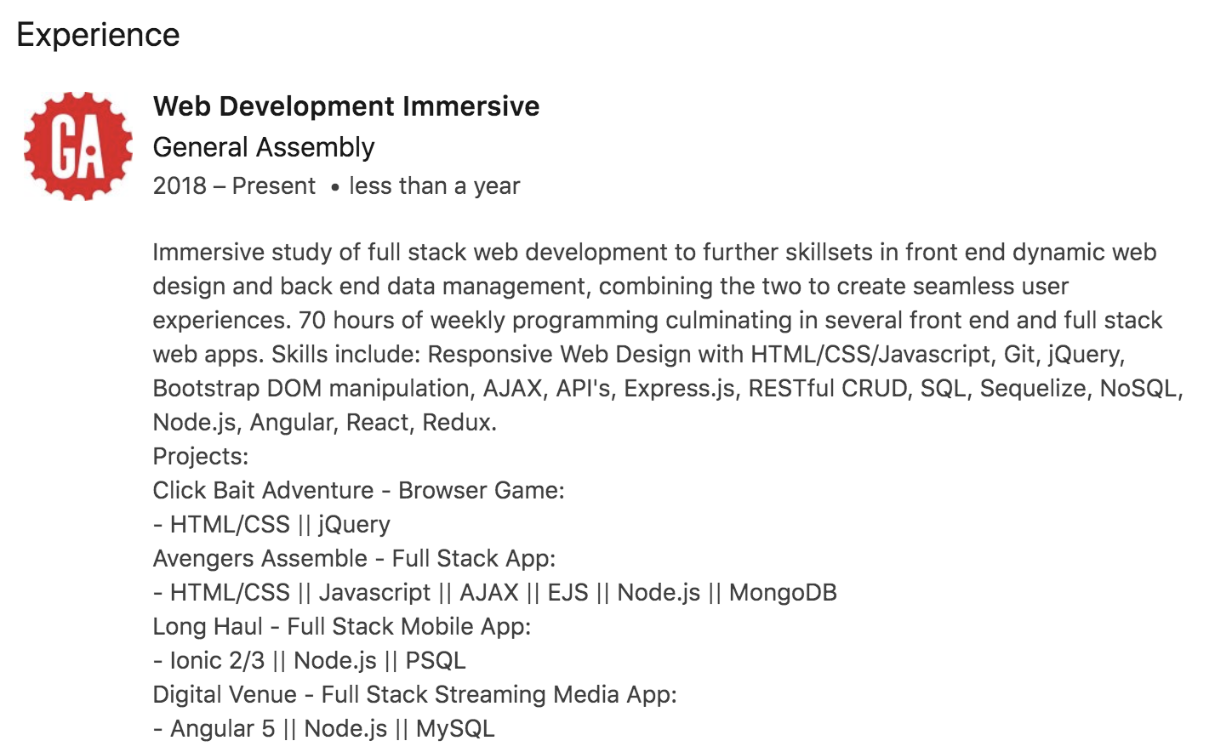
EXPERIENCE

Slide 81
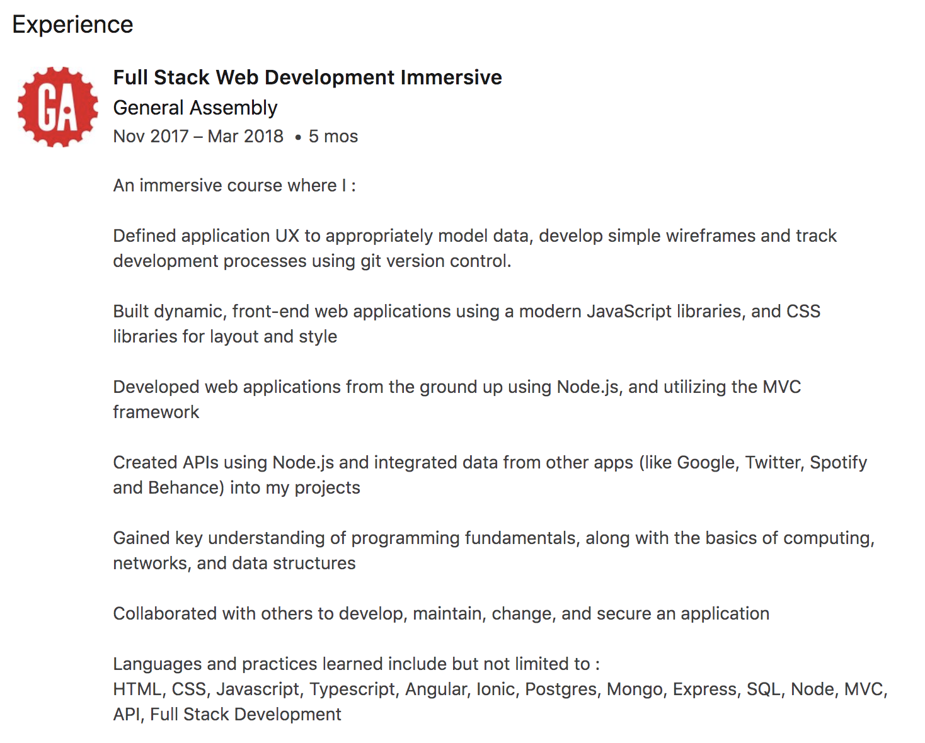
EXPERIENCE

Slide 82
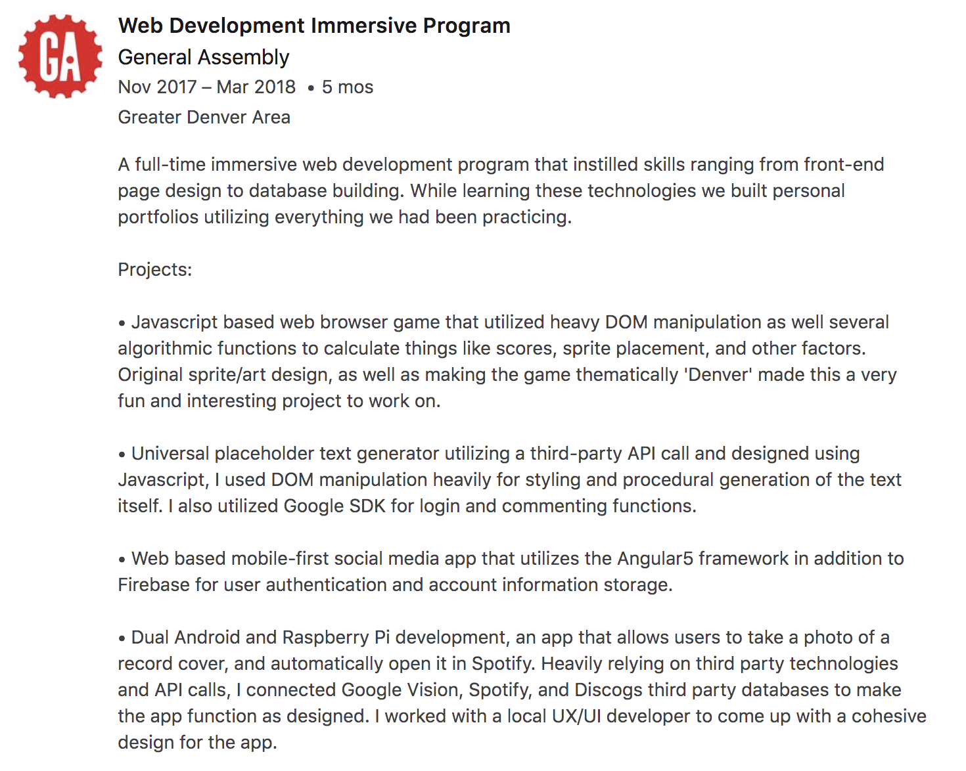
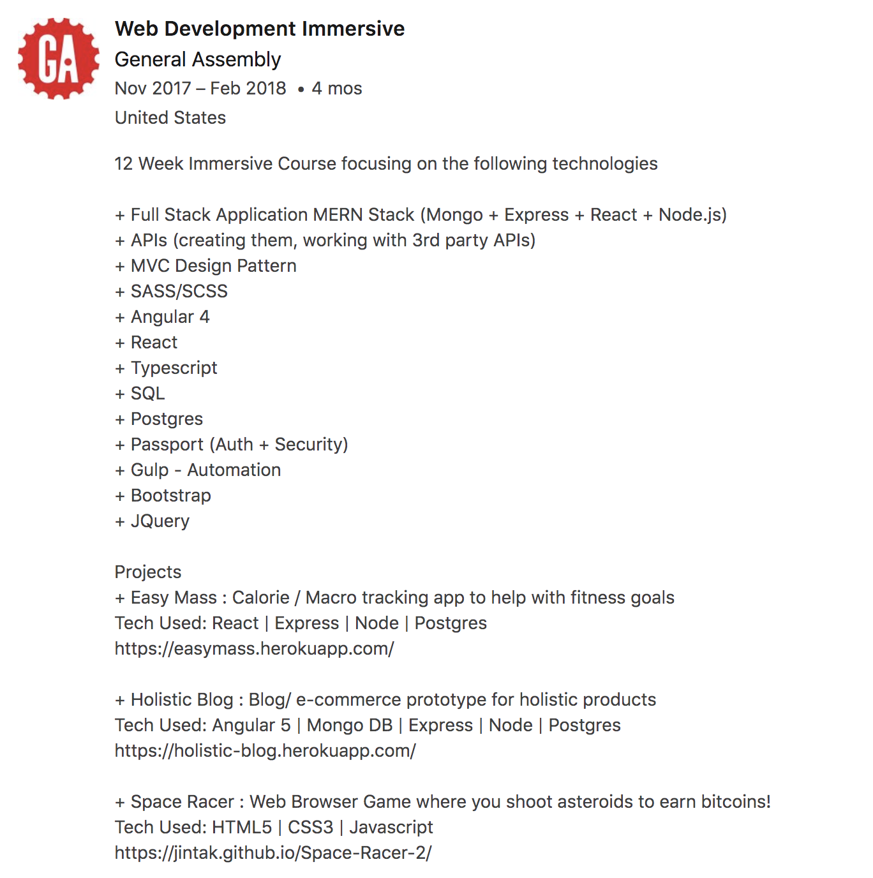
EXPERIENCE

Slide 83
LINKEDIN FOR CAREER CHANGERS
PROJECTS
Notes:
Draw [PROJECTS]
Name of project, brief description of each, skills associated with each

Slide 84
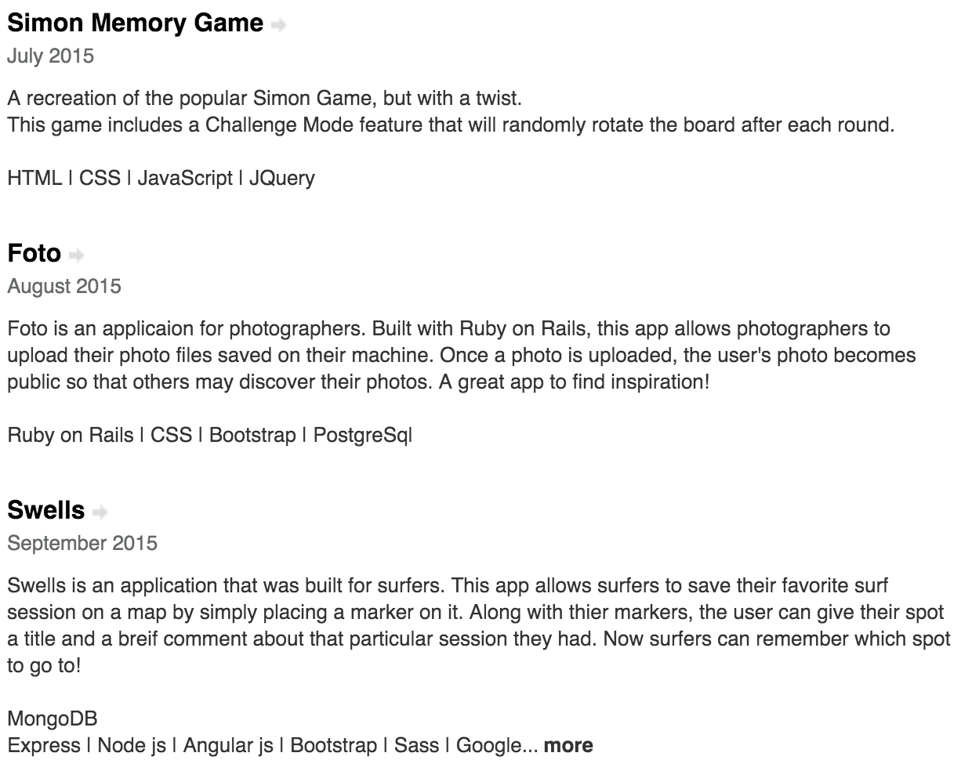
ADDITIONAL PROJECTS
Put them in your experience section
Notes:
Edit Profile, below the summary, find the box that says “projects.”
Separate but related section from Education. Should go above education section.
If you have good work experience, then it goes between EXPERIENCE and EDUCATION. If you don’t want to highlight your work experience, then it goes between SUMMARY and EXPERIENCE.

Slide 85
LINKEDIN
WORK SKILLS

Slide 86
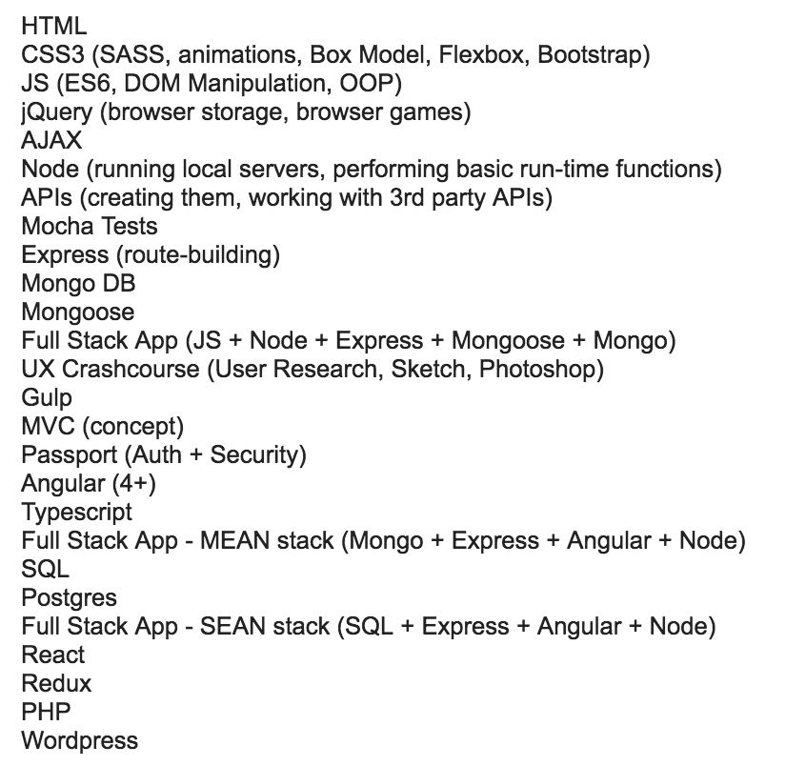
WEB DEVELOPMENT SKILLS

Slide 87
TRANSFERABLE SKILLS
Success metrics and transferable skills are most relevant to your pivot, not a detailed description of every task
Develop a content strategy for previous work that highlights web development skills and thought processes

Slide 88
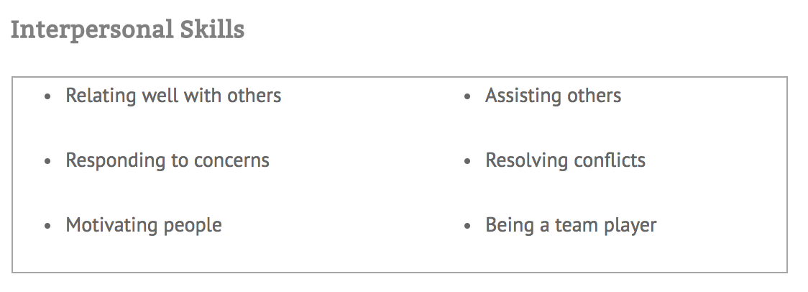
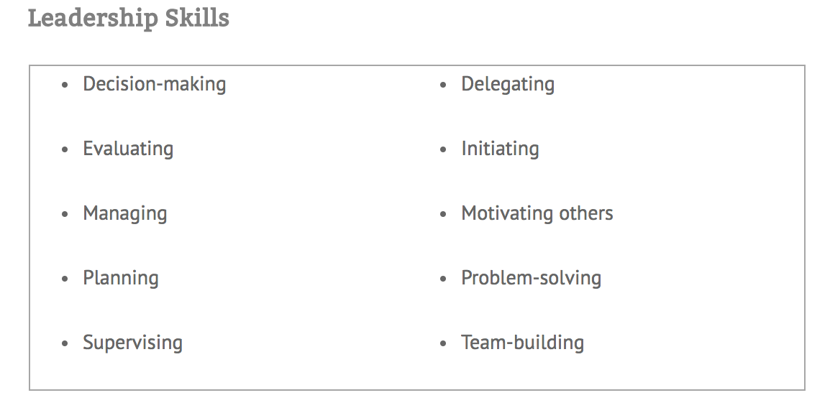
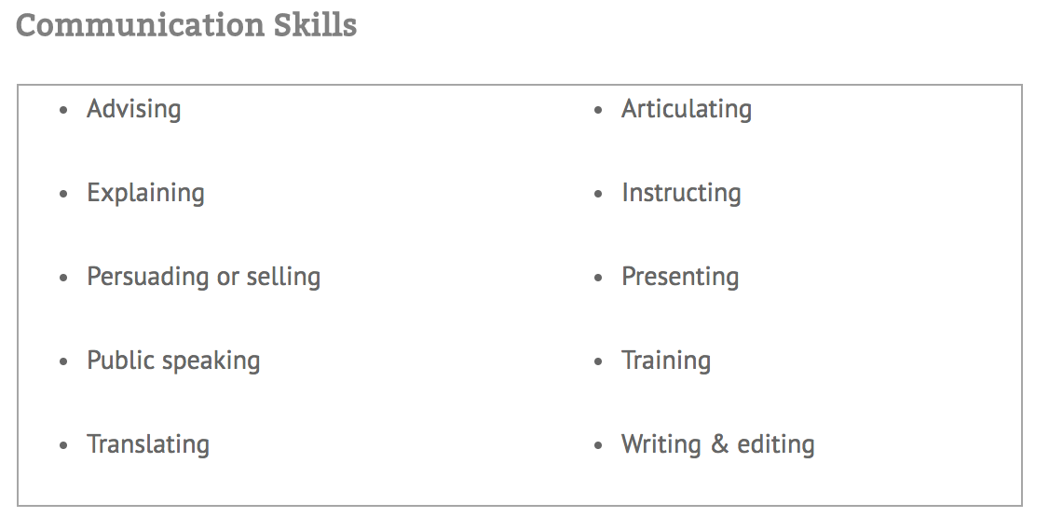
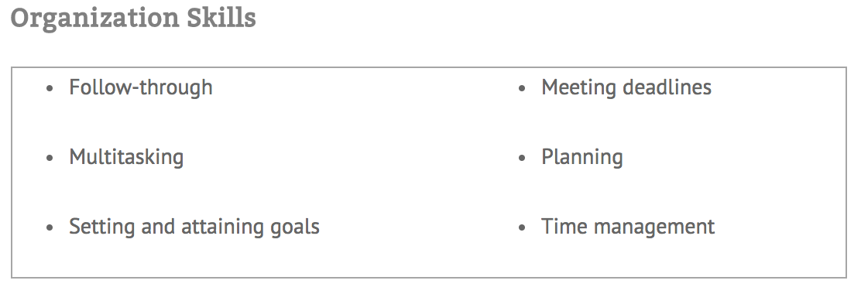
TRANSFERABLE SKILLS - GENERAL

Slide 89
LINKEDIN FOR CAREER CHANGERS
EDUCATION
Notes:
Draw [EDUCATION]
The final section (in this order) that employers care about, is the education section. Specifically, how GA is portrayed in your education.

Slide 90
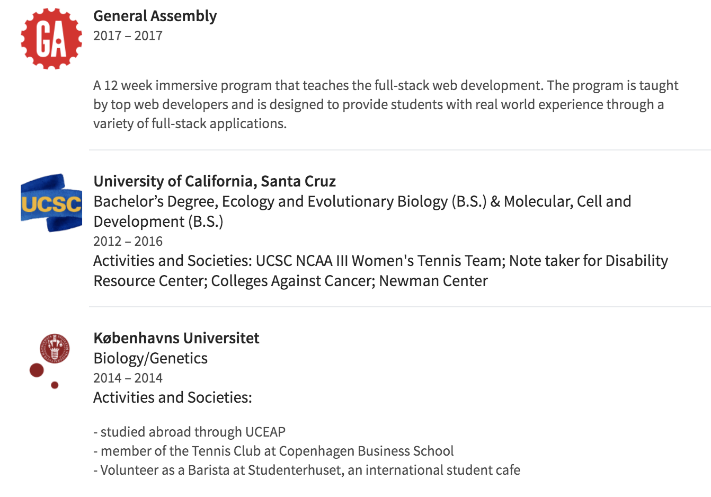
EDUCATION
List GA in education with brief blurb about the program

Slide 91
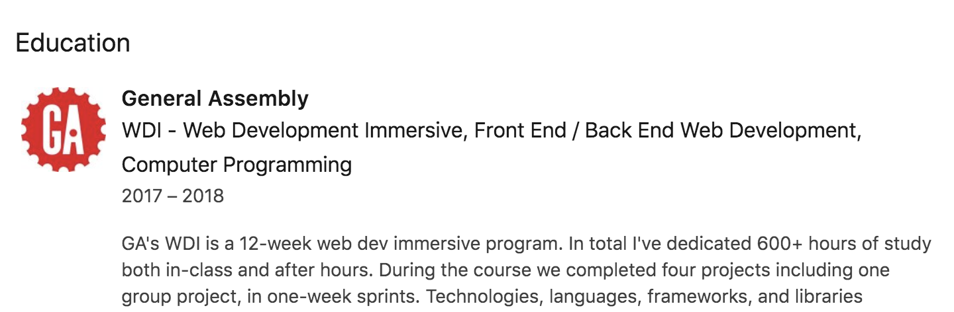
EDUCATION
Notes:
Even people who know GA… DSI students even…. don't always understand what you learn and how you learn and how truly IMMERSIVE, this experience is. YOU need to provide them with that context. You dove head first into the deep end of the pool and that’s pretty damn impressive.
480+ hours, 12 weeks, 5 days a week full time, 4 projects, 1 team project
Who is this?

Slide 92
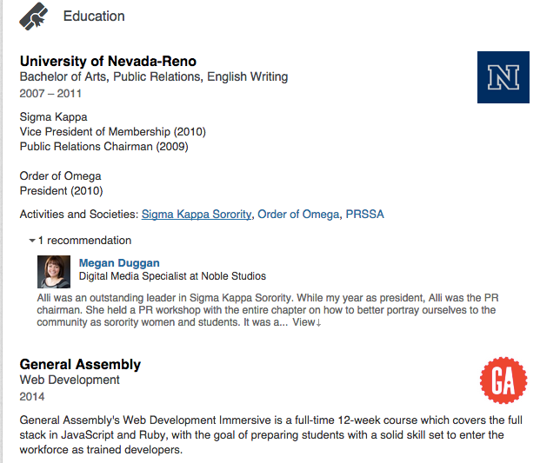
EDUCATION
Note: If your school is prestigious and you want it at the top, don’t add a date for GA.

Slide 93
LINKEDIN FOR CAREER CHANGERS
CONNECTING ON
Notes:
Draw [EDUCATION]
The final section (in this order) that employers care about, is the education section. Specifically, how GA is portrayed in your education.

Slide 94
CONNECTING ON LINKEDIN
Try to connect within 24 hours of meeting someone.
Always send a personalized note with your connection request.
Try to avoid adding connections through your mobile application because you cannot send a personalized note.
Remind the person where/how you met.
Or if you’re reaching out cold, explain why .
Be careful about adding your entire contact list to LinkedIn.
Don’t feel as though you need to accept requests if you don’t know the person.

Slide 95

CONNECTING ON LINKEDIN
Who do you know that knows someone that knows someone that knows someone that knows someone?
Think about how by connecting with one person can connect you to a whole new network of folks.

Slide 96
CONNECTING ON LINKEDIN
To mediate the issue of being unable to communicate with someone out of your network, you can request to connect with them and have your request include a note explaining why you are connecting and a call to action. An example:
Hi Jane,
I noticed you work with x organization and I have always been fascinated with the growth of the company and the role it plays in the technical community. I know x company has done some amazing things and as a UX developer student, I would love to hear about your path within the design industry. Would you be open to a cup of coffee or a brief phone call to share your experience? Also, I noticed X in your interests and would love to know more about your work in that area, too!
Thanks!
Note: By including the last line personalized to the individual’s interests versus their role or employer, you are attempting to build a relationship on a personal level, which will both entice the contact to connect with you and it mediates the feeling of “transactional” exchange a great deal!

Slide 97
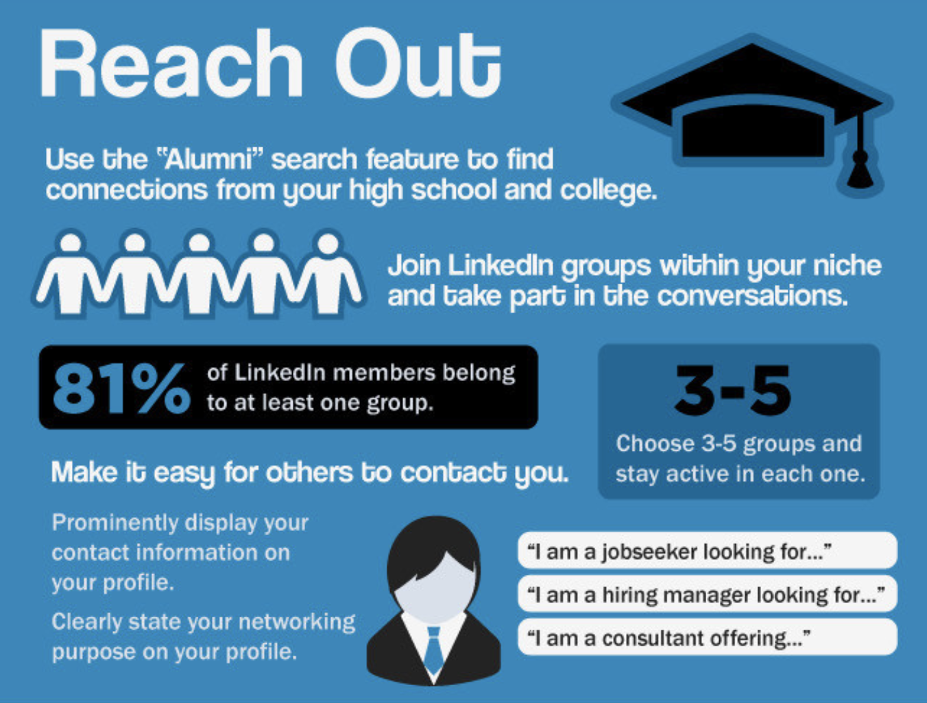
Building your Connections
How many connections do you currently have?
0? Make a goal of getting to 100
Quality over quantity!
Don’t add individuals you will never converse with or have never networked with--they are “dead weight” in your connections
Set a personal growth goal
Join Groups
Alumni, professional orgs, interest groups.
Follow companies you are interested in
LinkedIn - Extras

Slide 98
LOCATE GA ALUM
My Network Find Alumni Change University
Scroll down and type in “General Assembly”
Choose “Denver” (or any other cities you’d be interested in working in)

Slide 99
LINKEDIN FOR CAREER CHANGERS
ALL THE OTHER
STUFF
Notes:
Draw [EDUCATION]
The final section (in this order) that employers care about, is the education section. Specifically, how GA is portrayed in your education.

Slide 100
GETTING THE MOST OUT OF LINKEDIN
Join relevant groups
Follow your favorite companies
Follow thought leaders
Need a mentor? [techcrunch.com]
Read news articles on LinkedIn Pulse [pulse.me]
Read the LinkedIn Blog [blog.linkedin.com]
The Job Board!
Search, save jobs & searches, and apply for jobs

Slide 101
LINKEDIN PREMIUM
Visually enhance your profile with a larger photo, expanded header, exclusive gallery of images
Listing is 2x more prominent than other search results
Can apply as a featured applicant
Access full list of who has viewed your profile in the last 90 days
Additional search filters to find people, jobs
In mail credits each month
See how you rate against other applicants
Filter jobs by salary
Access to LinkedIn experts in groups
Saved search alerts
Introductions
Membership to lynda.com

Slide 102

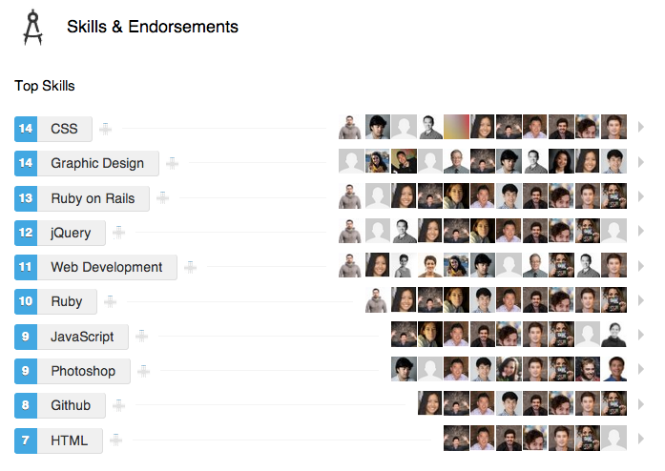
SKILLS + ENDORSEMENTS
LINKEDIN - EXTRAS
Make sure you have the skills that are most relevant to your job search at the top
Endorsements are helpful, not critical

Slide 103

Endorsement Etiquette
When someone endorses you, you should endorse them back!
You can add any skills to your profile that you want.
As a class, endorse one another. The more you each endorse one another,
The skills you want to show up, will move up on your profile.
LINKEDIN

Slide 104
LINKEDIN - RECOMMENDATIONS
When someone recommends you, you should always return the favour. If someone knows you well enough to speak to your talents, likely you should be able to do the same.
If you are looking for a recommendation and have not received one from an individual you’d like to do so, reach out to them and ask if they would be willing to post a recommendation -- note: when asking for a recommendation, people are often busy, so feel free to mention your willingness to draft up one and let them know they are welcome to edit it in any matter they choose upon your request for it.
LINKEDIN

Slide 105
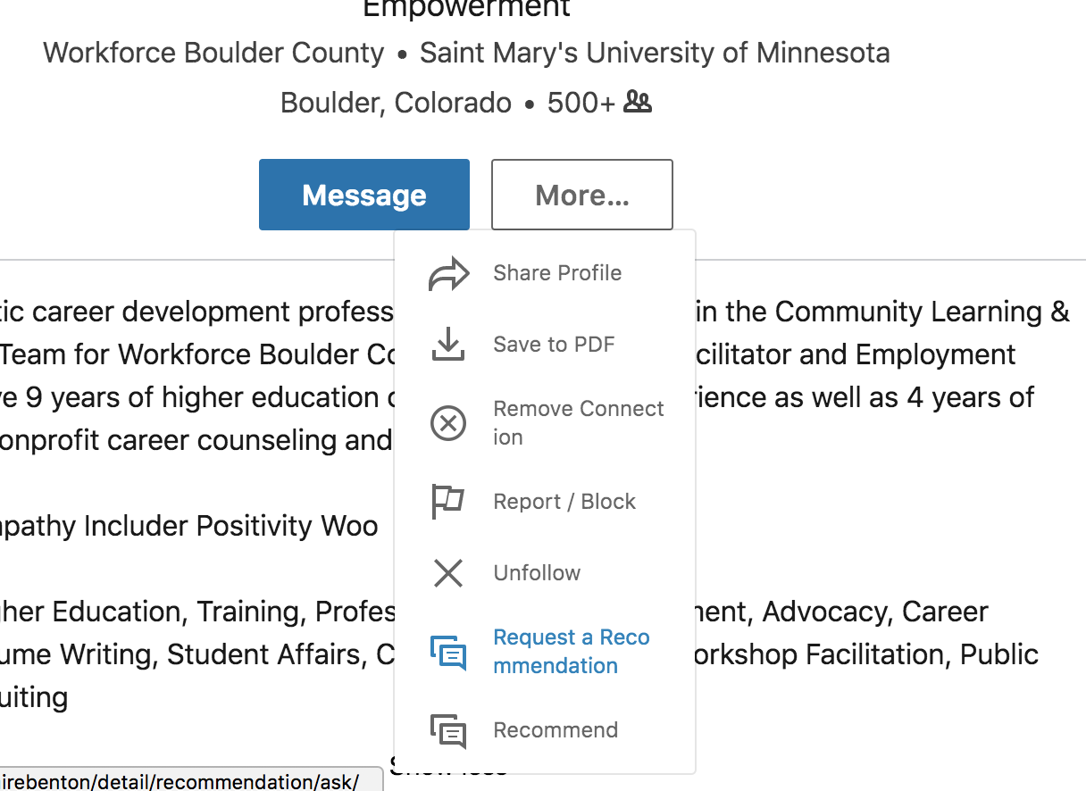

Slide 106
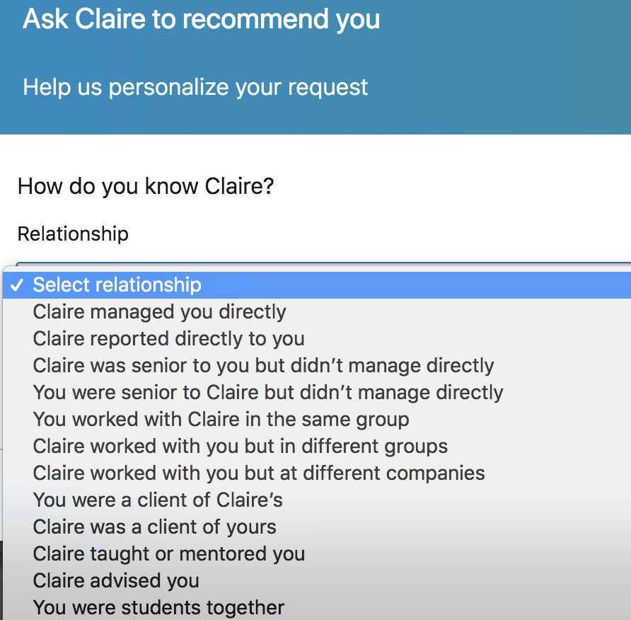
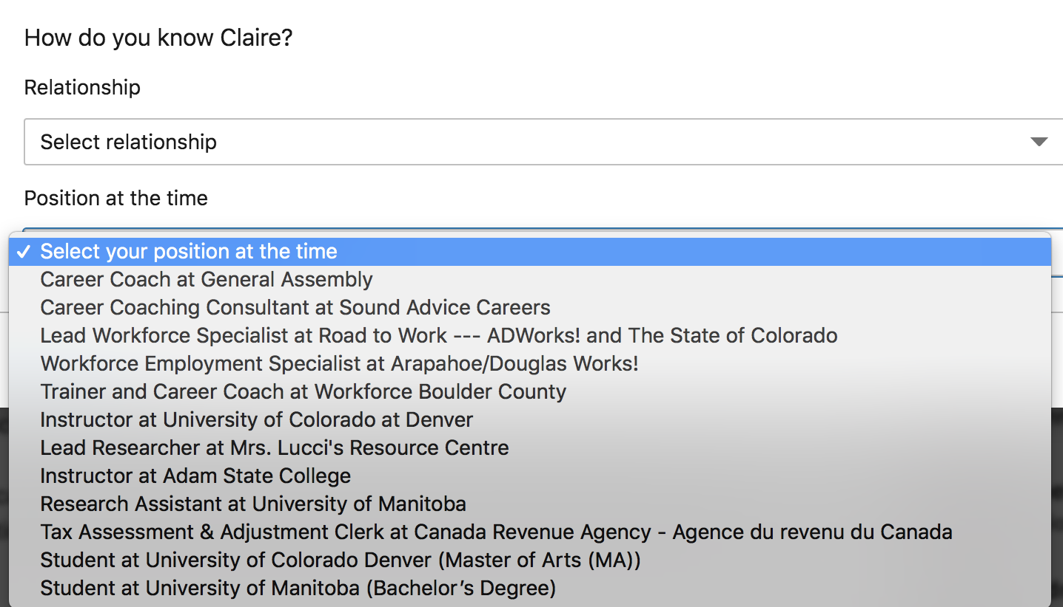

Slide 107
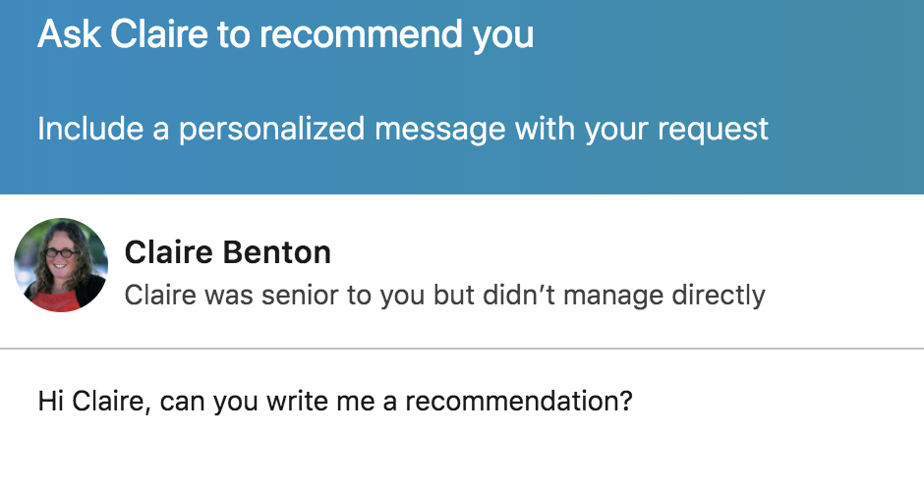


BAD Recommendation Request:
General Assembly

Slide 108
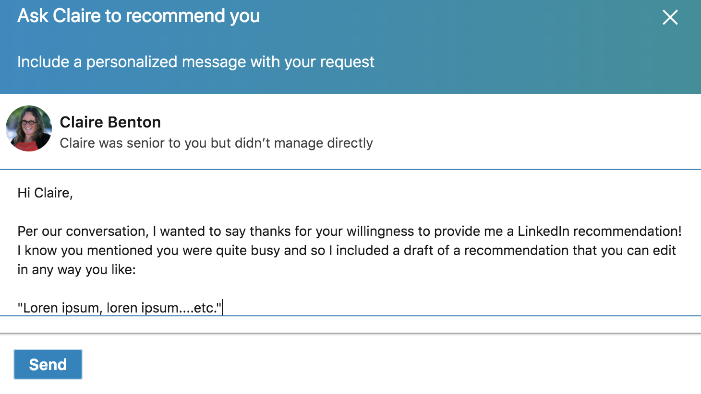

GOOD Recommendation Request:
General Assembly

Slide 109
LINKEDIN FOR CAREER CHANGERS
TARGETING
Notes:
But there is a second way, besides the brand, that we can figure out which keywords, skills and experiences we want to include in our EXPERIENCES section.
It’s something that I call TARGETING -

Slide 110

LINKEDIN FOR CAREER CHANGERS
TARGET ACTIVITY
Notes:
Next 5-10min = Find as many jobs as you can that you are interested in.
Go to - http://tagcrowd.com/

Slide 111
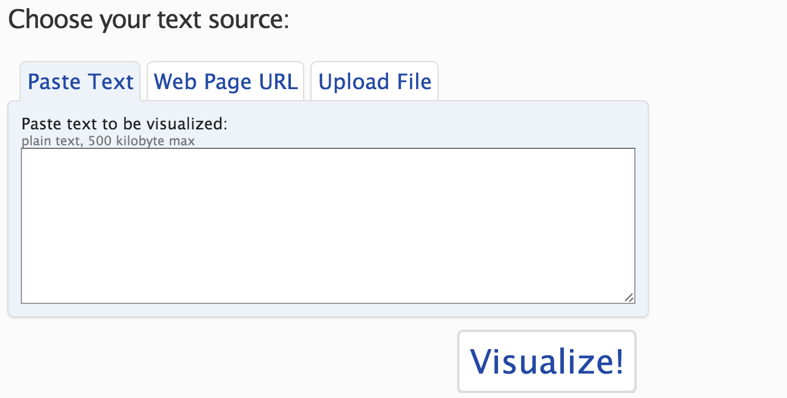
TARGETING
Notes:
Paste as many job descriptions as you want into the box and hit “Visualize”

Slide 112

TARGETING
Notes:
1 small tool that you can use to help target your personal narrative. If you are pitching yourself with the right skills - employers will starting thinking of you doing the job now.
The advantage of doing this is actually 2-fold:
Immediately, you get an idea of any specific skills you have to have on LinkedIn to be thought of for the job(s) you want.
But more importantly and at a higher level… the reason applying online is such a black hole right now is because of keywords. People think about keywords but don’t think about it literally…
There, Their, They’re - dumb searches.

Slide 113
LINKEDIN FOR CAREER CHANGERS
FINALLY…
Notes:
Go back to drawing…

Slide 114

FINALLY…
Notes:
Here’s how I think about this -
Do you remember this movie? If you haven’t seen it, the premise is that you can plant an idea into someone’s head and influence their behavior.
This is the game we are playing. As a career changer, you are telling me exactly how to think about you with your LinkedIn and then I’m aren’t surprised when they think about you that way.
Little tiny box, stood out to me with your title and your skills, right upfront.
Brand Summary —> Experience
Technical Skills —> Projects
Planting a seed. Who you are in full, right at the top, so I know what to look for.
IMPORTANT: What happens when you tell me up front what’s valuable about your previous life and how it connects to DSI?
When I get to your experience section and I don’t see any “Data Scientist” titles, I still see value. YOU control the narrative. YOU planted the seed
Hopefully you can see why we start at the brand - and why it really is the foundation of your search post GA.
It’s like Magic… Inception
Questions?

Slide 115



GETTING THE MOST OUT OF LINKEDIN
LINKEDIN - EXTRAS
Join relevant groups (JS devs, Colorado grads, etc.)
Follow your favorite companies
Use advanced search to find hiring managers
Share, read, and comment on articles
Search for jobs, and see who you know at the company

Slide 116

DIGITAL PRESENCE AND TOOLS
GITHUB
Notes:
Fairly new as a hiring tool.
Few programmers were able to show full work since they were tied directly to private work.
Github changed that.

Slide 117
GITHUB
GITHUB IS YOUR CODE PORTFOLIO
Sometimes Github is all you need to prove you are a strong developer.
Keep it clean and neat, and always be adding to it!
At the end of the course, have your colleagues star your top repositories.
Notes:
It is NOT your resume.
It’s supplemental evidence of your abilities and points of conversation.
Make sure you show completed work and not lots of half baked ideas. Be intentional.
** Make sure to have your repos reviewed for readability before send them off, even if it works. Co-workers will want to see your style of coding.
https://techbeacon.com/what-do-job-seeking-developers-need-their-github

Slide 118

DIGITAL PRESENCE - GITHUB

Slide 119
DIGITAL PRESENCE AND TOOLS
MORE PLATFORMS

Slide 120
DIGITAL PRESENCE AND TOOLS
Notes:
“I don’t need a LinkedIn”
“I have never needed one”
Necessary Evil
We don't live in a world anywhere where you CANT have LinkedIn and be a job seeker. Especially a career changing job seeker. More than just finding your “digital presence,” You have to give employers a way to think about you. You have to tell them how to think about you.
But you don't have to have every section of LinkedIn filled out. There are only 6 places that really matter. But before that, we need to make some changes.

Slide 121

MORE PLATFORMS
Notes:
Facebook
Twitter
Instagram
Tumblr
Medium

Slide 122
DIGITAL PRESENCE AND TOOLS
BLOGGING
Notes:
Go back to drawing…

Slide 123



BLOGGING

Slide 124



Blogging Sites
YOUR OWN PERSONAL SITE?

Slide 125
QUESTIONS? COMMENTS? CONCERNS?

Slide 126
RESOURCES
LINKEDIN
Leveraging LinkedIn to Change Careers
Craft a Killer LinkedIn Headline
5 Templates That’ll Make Writing the Perfect LinkedIn Summary a Breeze Link 3
Leveraging LinkedIn to Change Careers
Browse the General Assembly University Page
Join the GA Alumni LinkedIn Group
SOCIAL MEDIA + BLOGGING
Tips for a Winning Github
I Found My Mentor on Social Media
Why you should blog to get your next job

Slide 127
STOP & JOT
What are the two main things you should have on your LinkedIn?
Why are they important?

Slide 128
ASSIGNMENTS

Slide 129
OUTCOMES EXPECTATIONS - Due April 4th
Week Two:
What’s my brand worksheet
o https://goo.gl/forms/s7qDGunivtjm2cub2
Work on LinkedIn using LinkedIn check sheet
o https://docs.google.com/document/d/1_hUYTTiR-r7IZW6176g7xBtE4EHXDTVPt45qhc1VX8s/edit
Update LinkedIn url to toolkit and provide feedback for three peers
O docs.google.com/spreadsheets/d/107K74Wyu8mWUFfNqfzW9ezPoKbye6yQ0JrKD00vYR-I/edit?usp=sharing
Identify one meet up to attend while in class
Reach out to one of the alumni you met last week with a personalized greeting and ask to meet or have a one-on-one chat about their experience and any advice they may have

Slide 130
FINAL THOUGHTS
GA OUTCOMES

Slide 131

IMPOSTER SYNDROME
Notes:
Impostor syndrome is a term coined in 1978 by clinical psychologists Dr. Pauline R. Clance and Suzanne A. Imesreferring to high-achieving individuals marked by an inability to internalize their accomplishments and a persistent fear of being exposed as a "fraud".[1] Despite external evidence of their competence, those exhibiting the syndrome remain convinced that they are frauds and do not deserve the success they have achieved. Proof of success is dismissed as luck, timing, or as a result of deceiving others into thinking they are more intelligent and competent than they believe themselves to be. Some studies suggest that impostor syndrome is particularly common among high-achieving women.[2]
David Walsh - https://davidwalsh.name/impostor-syndrome

